Slide 1
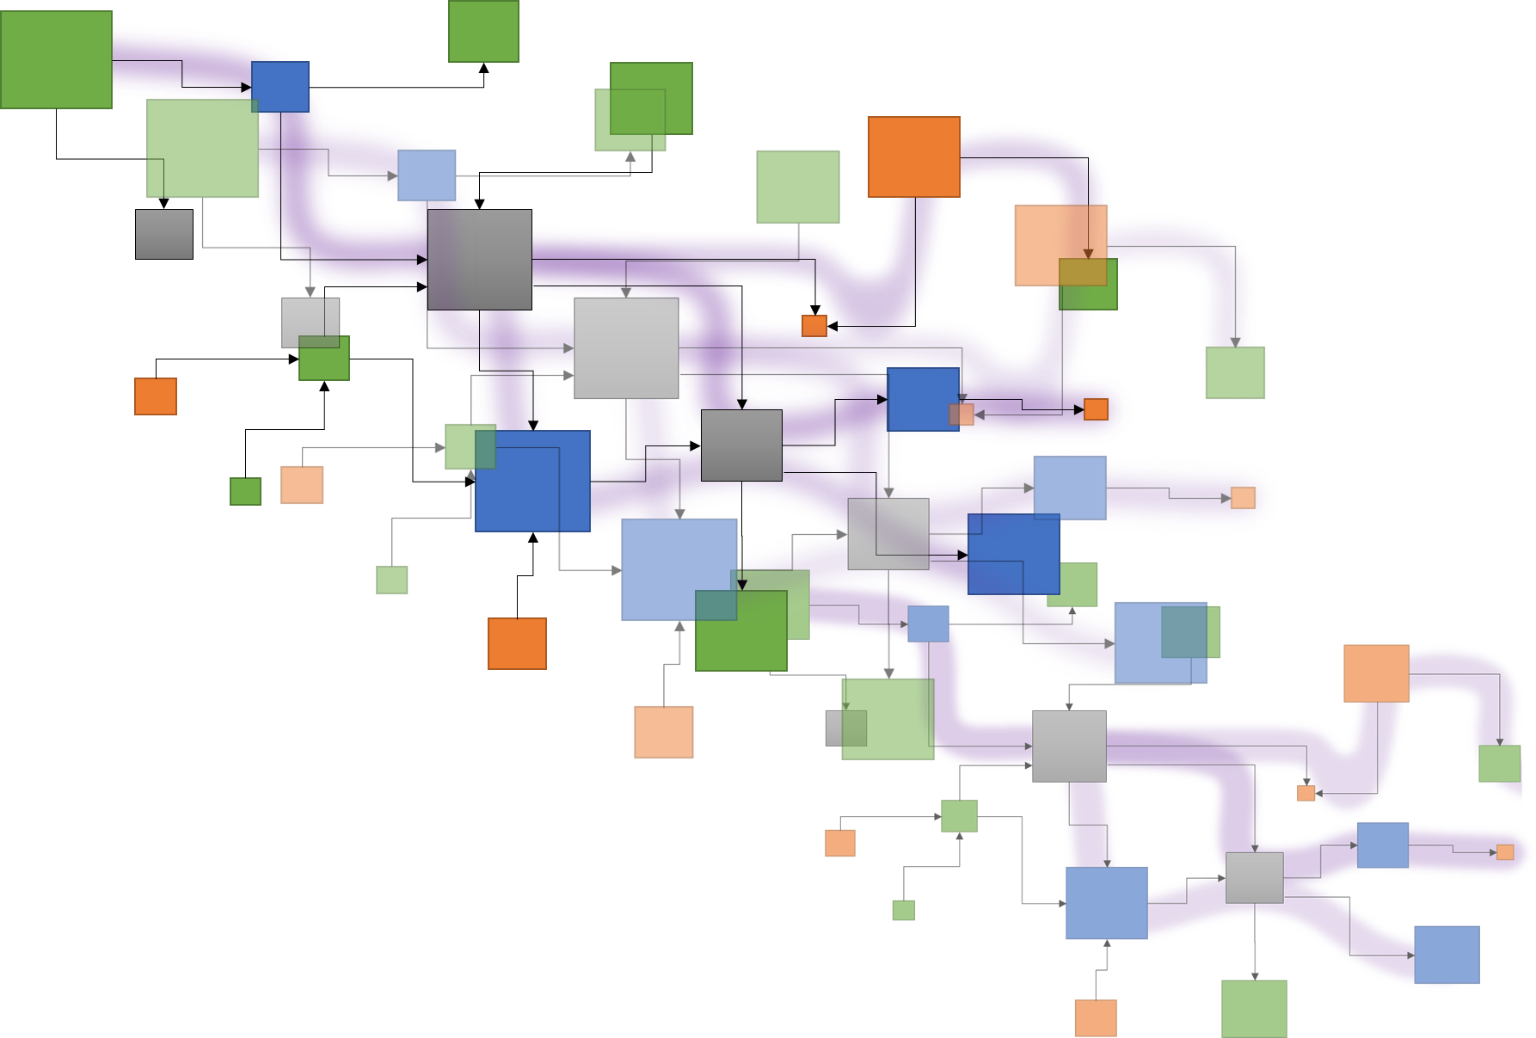
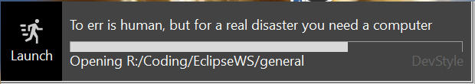





Tracea – 6th deliverable
Reference forensic
Deliverable 6
Exploring Papyrus typology
Traceα
A study of Papyrus:
Topology and complexity of
DSL modeling
Edouard R. Batot
Mai 2022

Slide 2
Tracea – 6th deliverable
A study of Papyrus –
Topology and complexity of DSL modeling
Reference forensic
Task 6:
Exploring Papyrus typology
Evaluation of the potential advantages of using the distance valuation for dealing with the complexity of traceability. Potential study case: establish a heat chart for the change impact analysis.
Deliverable 6:
Case study. Exploration of different scenarios that would benefit from a socio-technical traceability language or distance functions to reduce accidental complexity thanks to tracing. (For example: customization of views according to the "distance" between the artefacts on a matrix heat chart) (Task 3).
Edouard R. Batot
Mai 2022

Slide 3
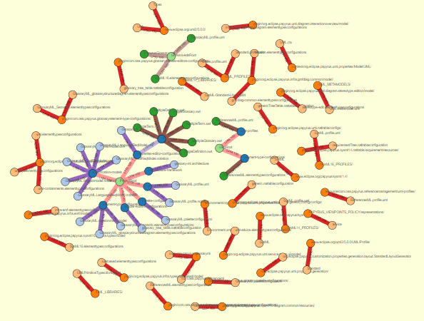
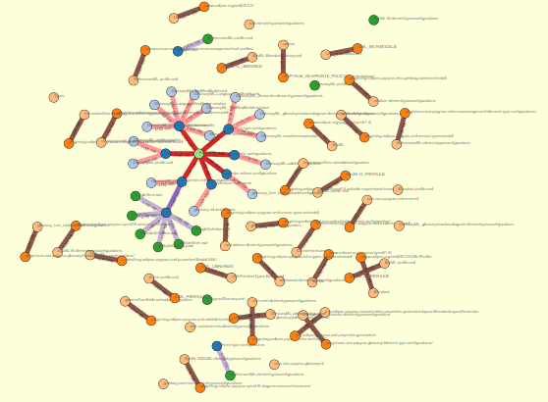
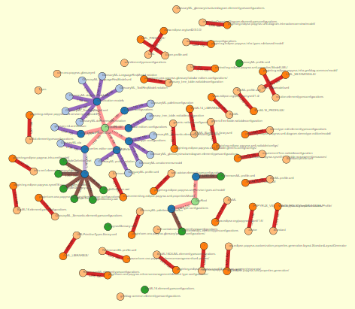
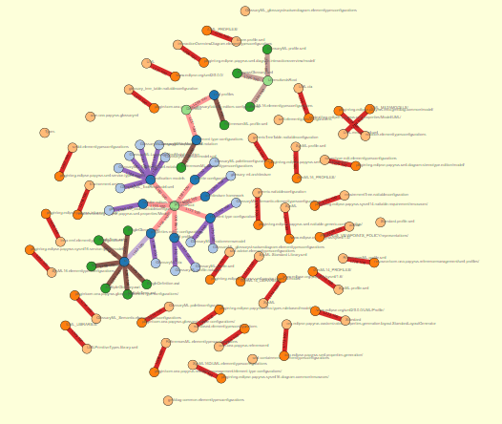
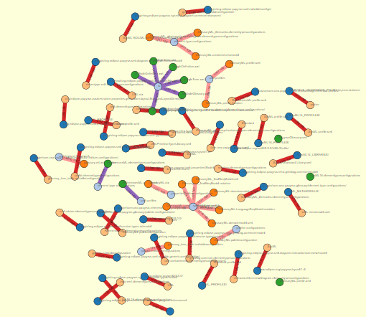
Papyrus topology and complexity an automated overview
Deliverable 6
Traceα
Orchestration for DSL modeling
Inter-module connections
Edouard R. Batot
Mai 2022

Slide 4
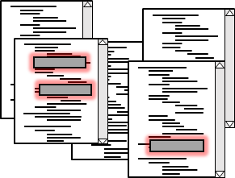
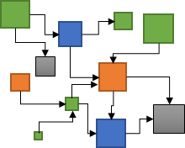
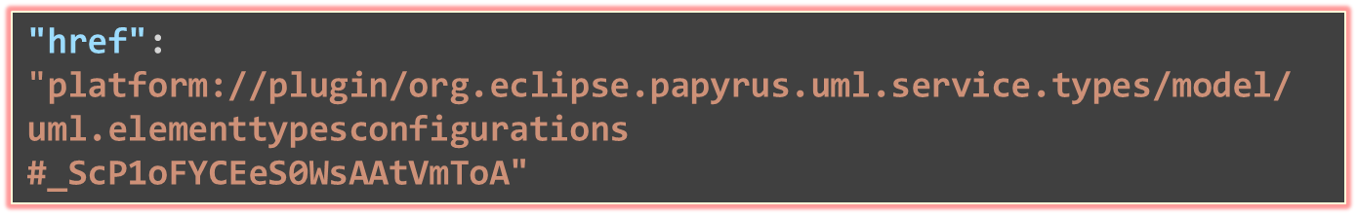
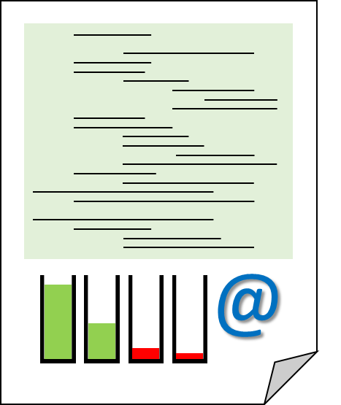
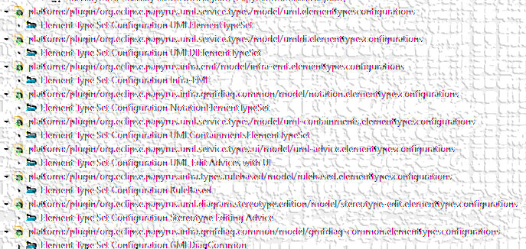
Reference forensic
What is a reference
Nature, source
Solvability
What matters in a reference
Source file, target,
Frequency?
Reference forensic
Exploring Papyrus typology
"href": "platform://plugin/org.eclipse.papyrus.uml.service.types/model/
uml.elementtypesconfigurations
#_ScP1oFYCEeS0WsAAtVmToA"
HREF
Protocol
://
location
Context
name
#
File artefacts
innerlocation
Precise target element
EMF Realm

Slide 5


Reference forensic
Root folder
Reference forensic
Root
Path to element
Path to element
Specific Element
Exploring Papyrus typology
Path to element
External file
Related
libraries
Specific Element
View
Context
External file
Specific Element
Design
Architecture
Palettization
External location
Local file
Profiling
Element Type configuration
Code
Related project
Project
EMF Realm
Local root

Slide 6
Persistence break.
Folder
File
File
File
Elt
Elt
Folder
Elt
Elt
Elt
Folder
File
File
File
File
File
File
Elt
Elt
Elt
Elt
Elt
Elt
Elt
Elt
Elt
Elt
Elt
Elt
Structure
Elt
External Location
External Location
Elt
Elt
Elt
External
Location
Local
Folder
resolves?
External Location
Context
exists?
External
File
Local
File
File Artefacts
Element
Precise
Target

Slide 7
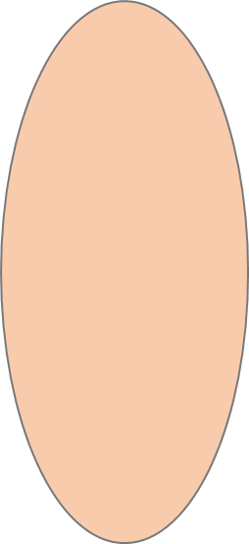

Reference forensic
Reference forensic
Projects
Exploring Papyrus typology
Dependences
External locations
Unresolved locations

Slide 8
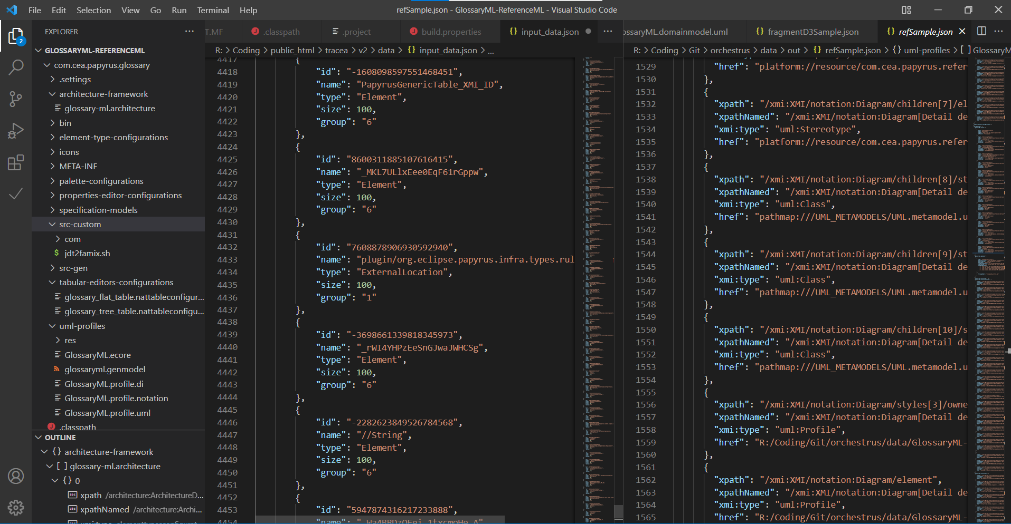
Persistence break.
Reference forensic
XMI
Artefacts
Configuration
Exploring Papyrus typology
Custom
Java
Modeling
persistence

Slide 9
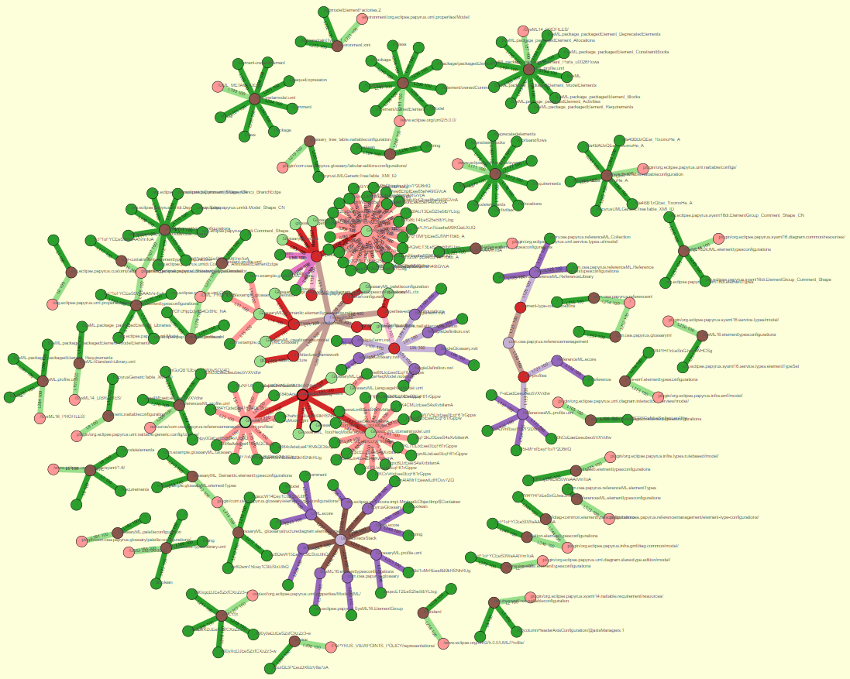
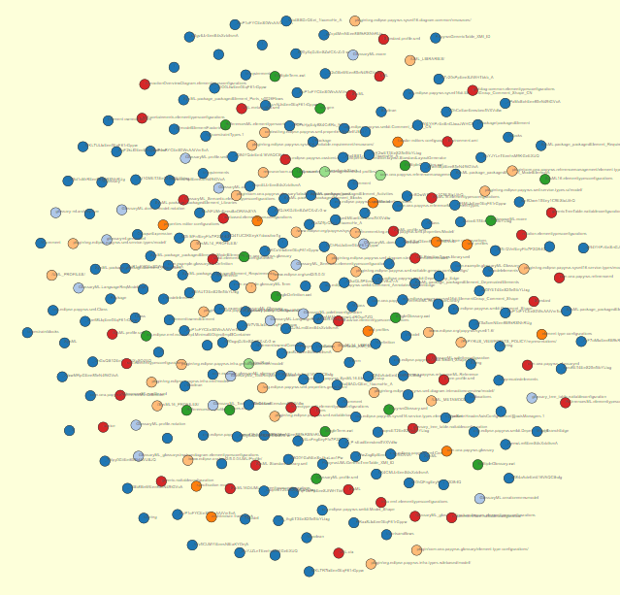
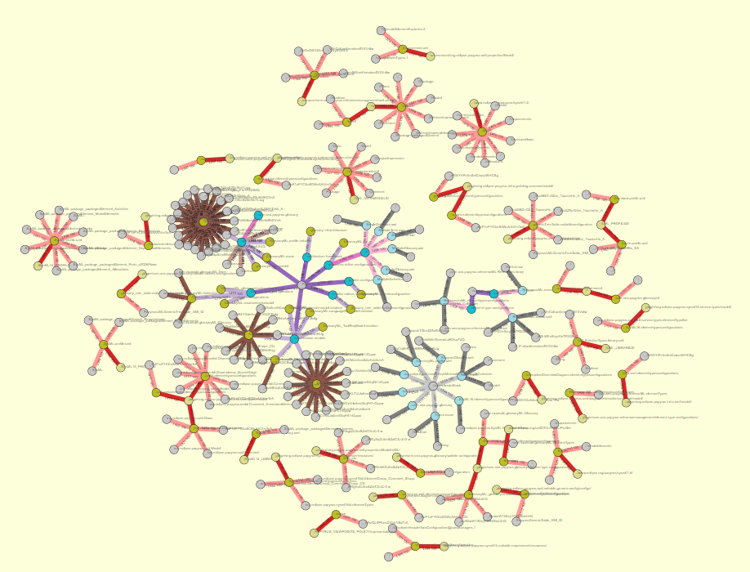
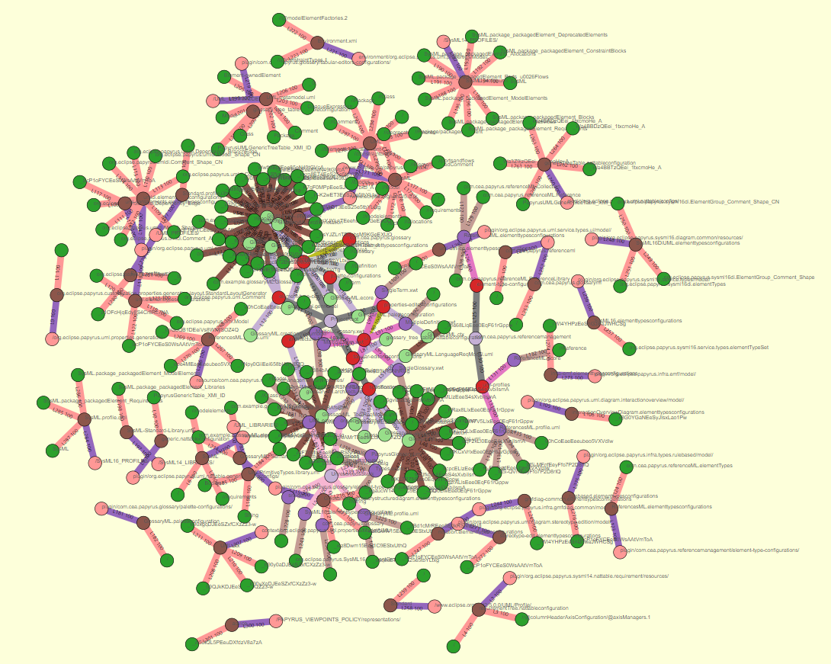
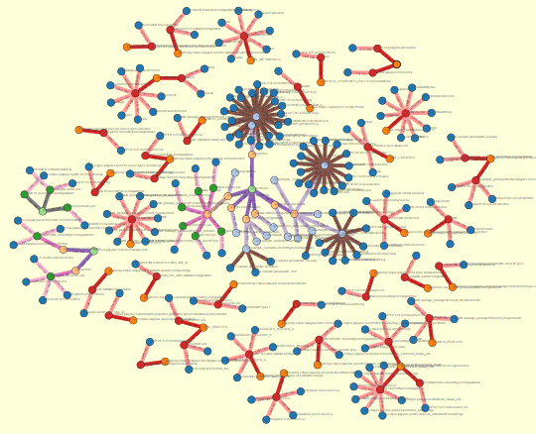
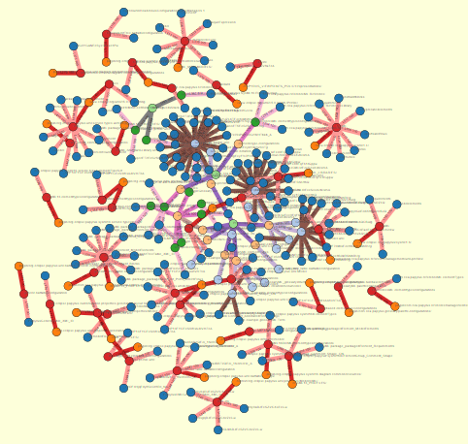
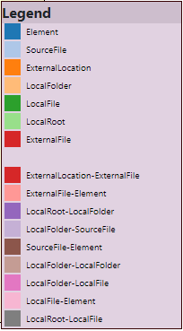
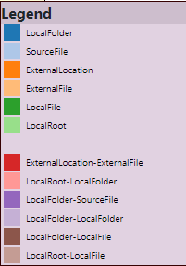
Topology and distance in a Papyrus project
Reference forensic
Exploring Papyrus typology
data/input_trace_data.json&nc=4&lc=4

Slide 10



















Topology and distance in a Papyrus project
Reference forensic
Exploring Papyrus typology
The bigger an element,
The most accessed

Slide 11
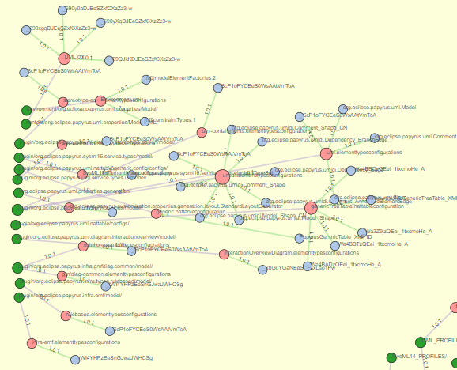
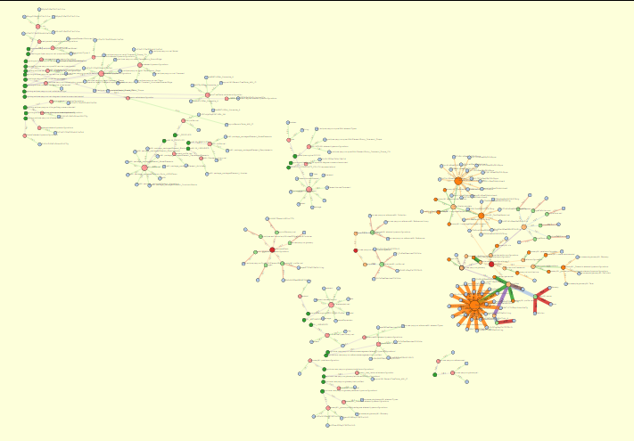
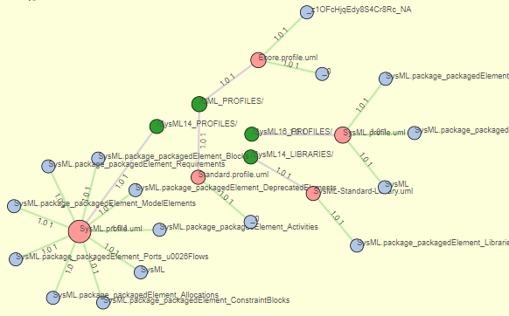
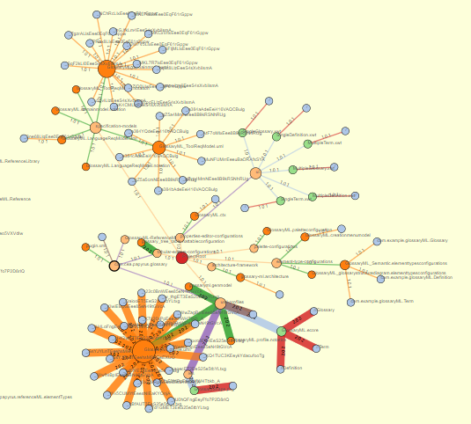
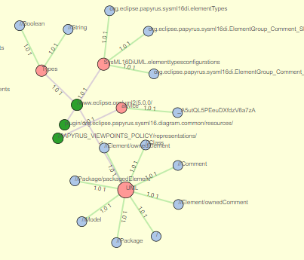
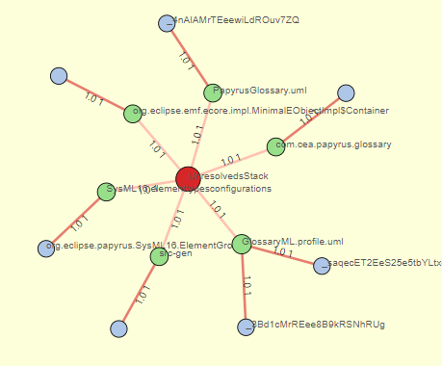
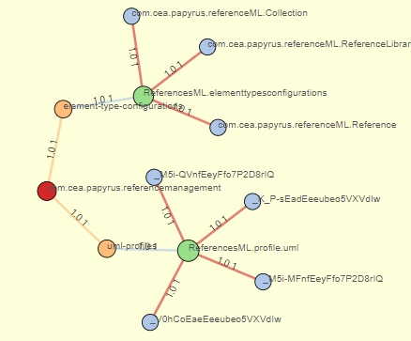
Topology and distance in a Papyrus project
Reference forensic
Papyrus
Exploring Papyrus typology
UML
GlossaryML
SysML
Unresolved
ReferenceML

Slide 12
Parameters
Source java files / custom
URI recognition REGEX
UX on the fly

Slide 13
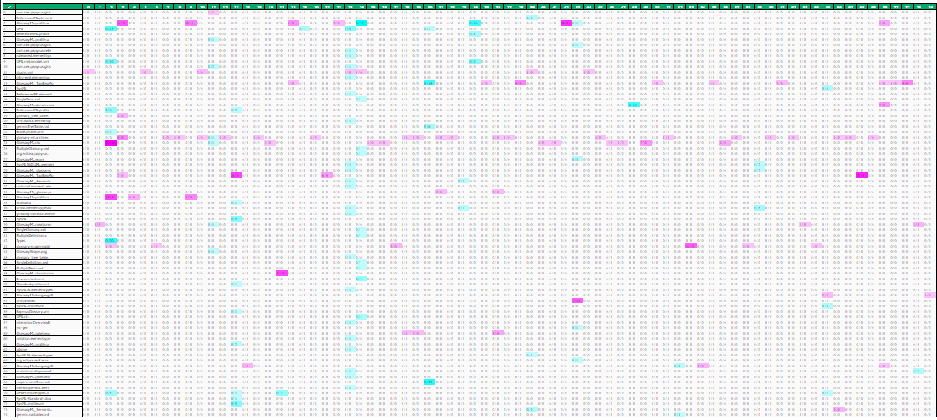
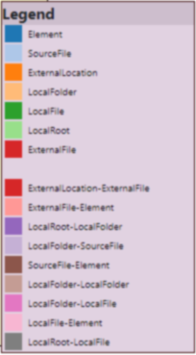
Topology and distance in a Papyrus project
Reference forensic
Customization of views according to the "distance" between artefacts
Socio-technical traceability language
Confidence / Energy valuation
Visualization parameters
Weighted adjacency matrix
Exploring Papyrus typology
A matrix heat chart

Slide 14
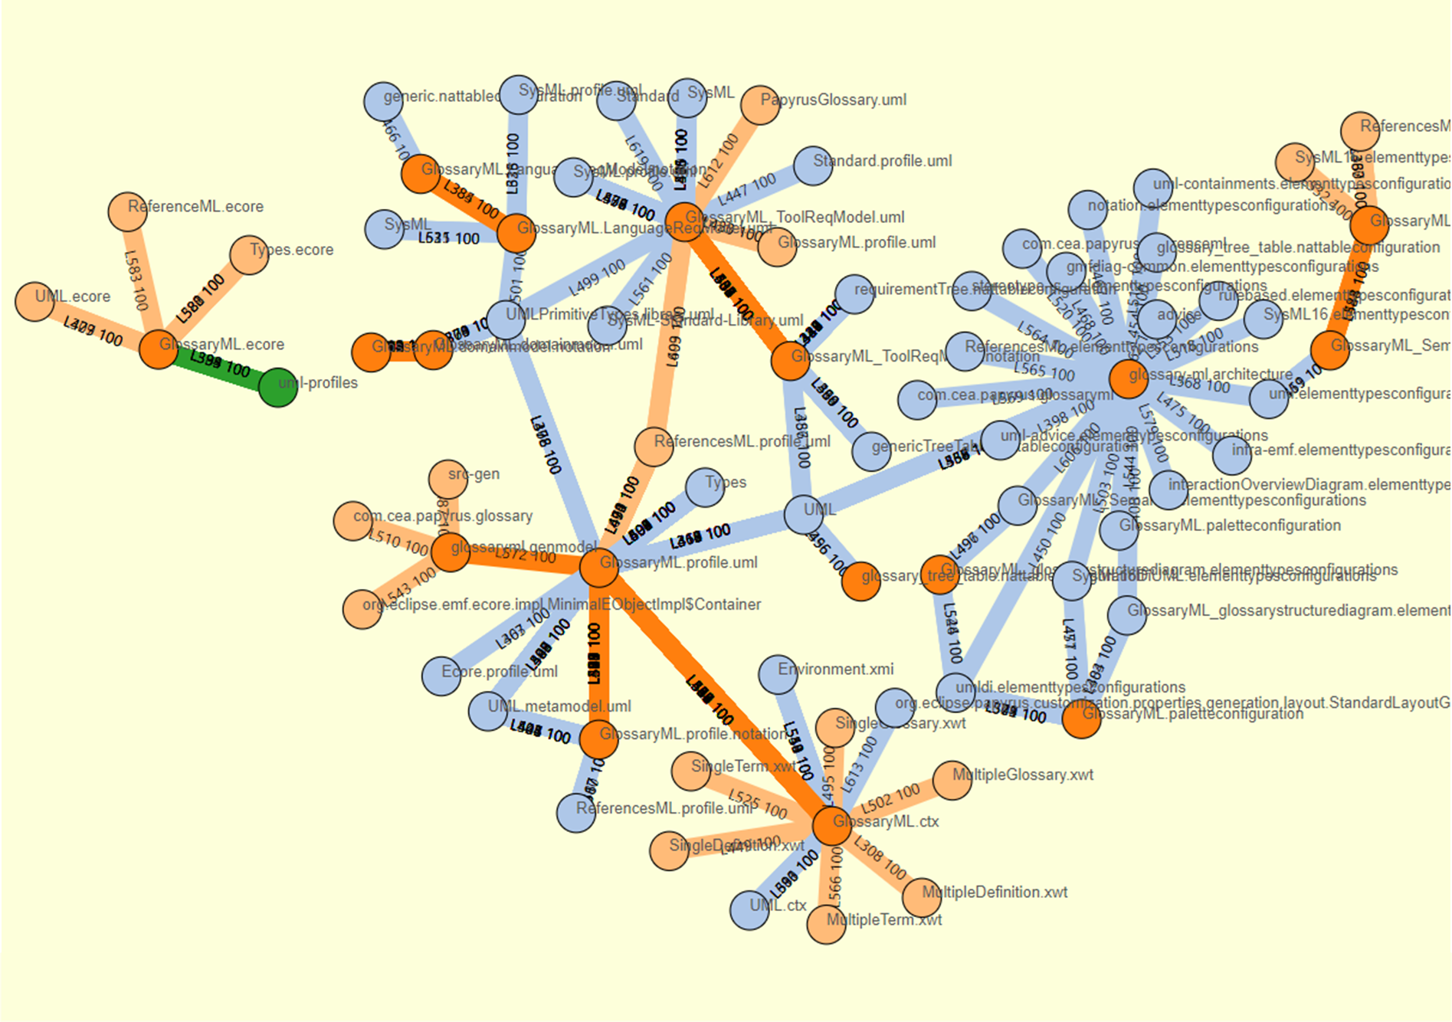
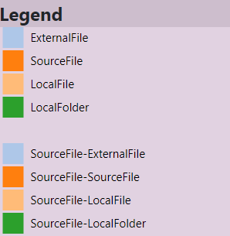
Complexity of
a Papyrus project
Reference forensic
Exploring Papyrus typology

Slide 15
Complexity of
a Papyrus project
Reference forensic
Exploring Papyrus typology
Links’ width correlates with
The number of accesses

Slide 16
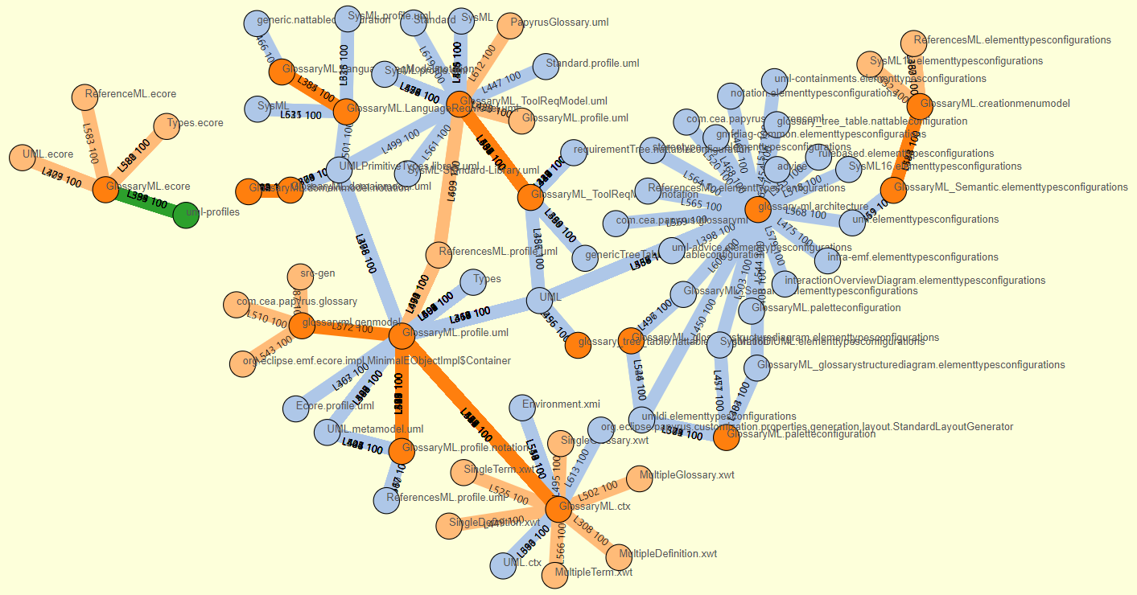
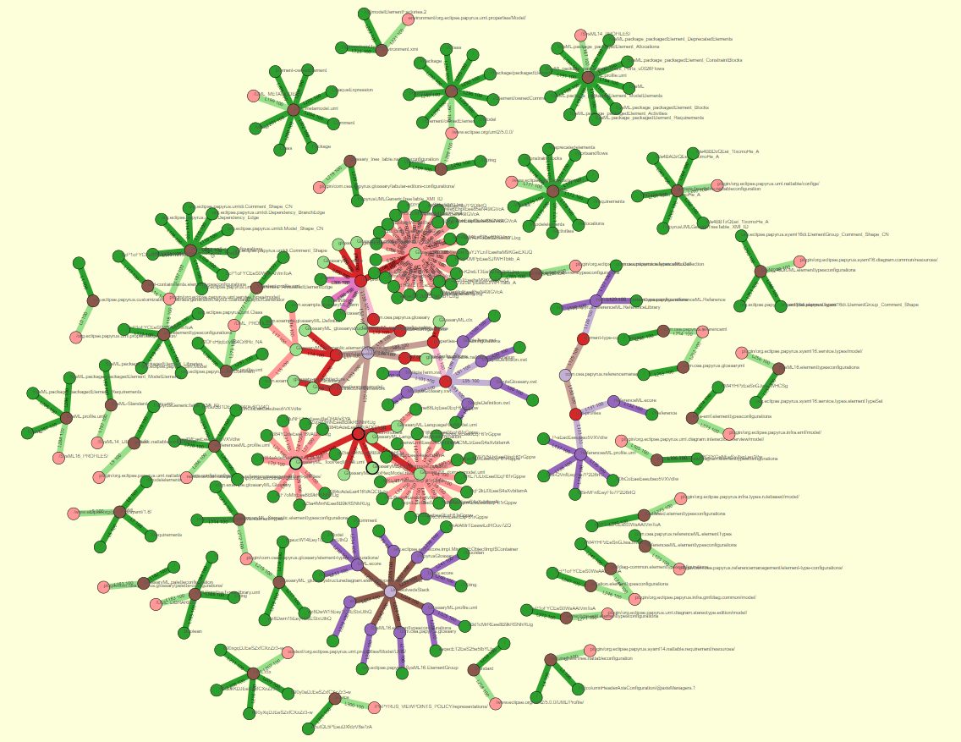
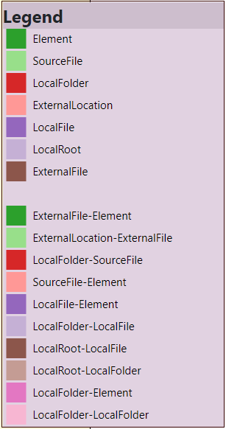
Multi layer representation
Reference forensic
Exploring Papyrus typology
¿Topology & Complexity
in a single perspective?

Slide 17
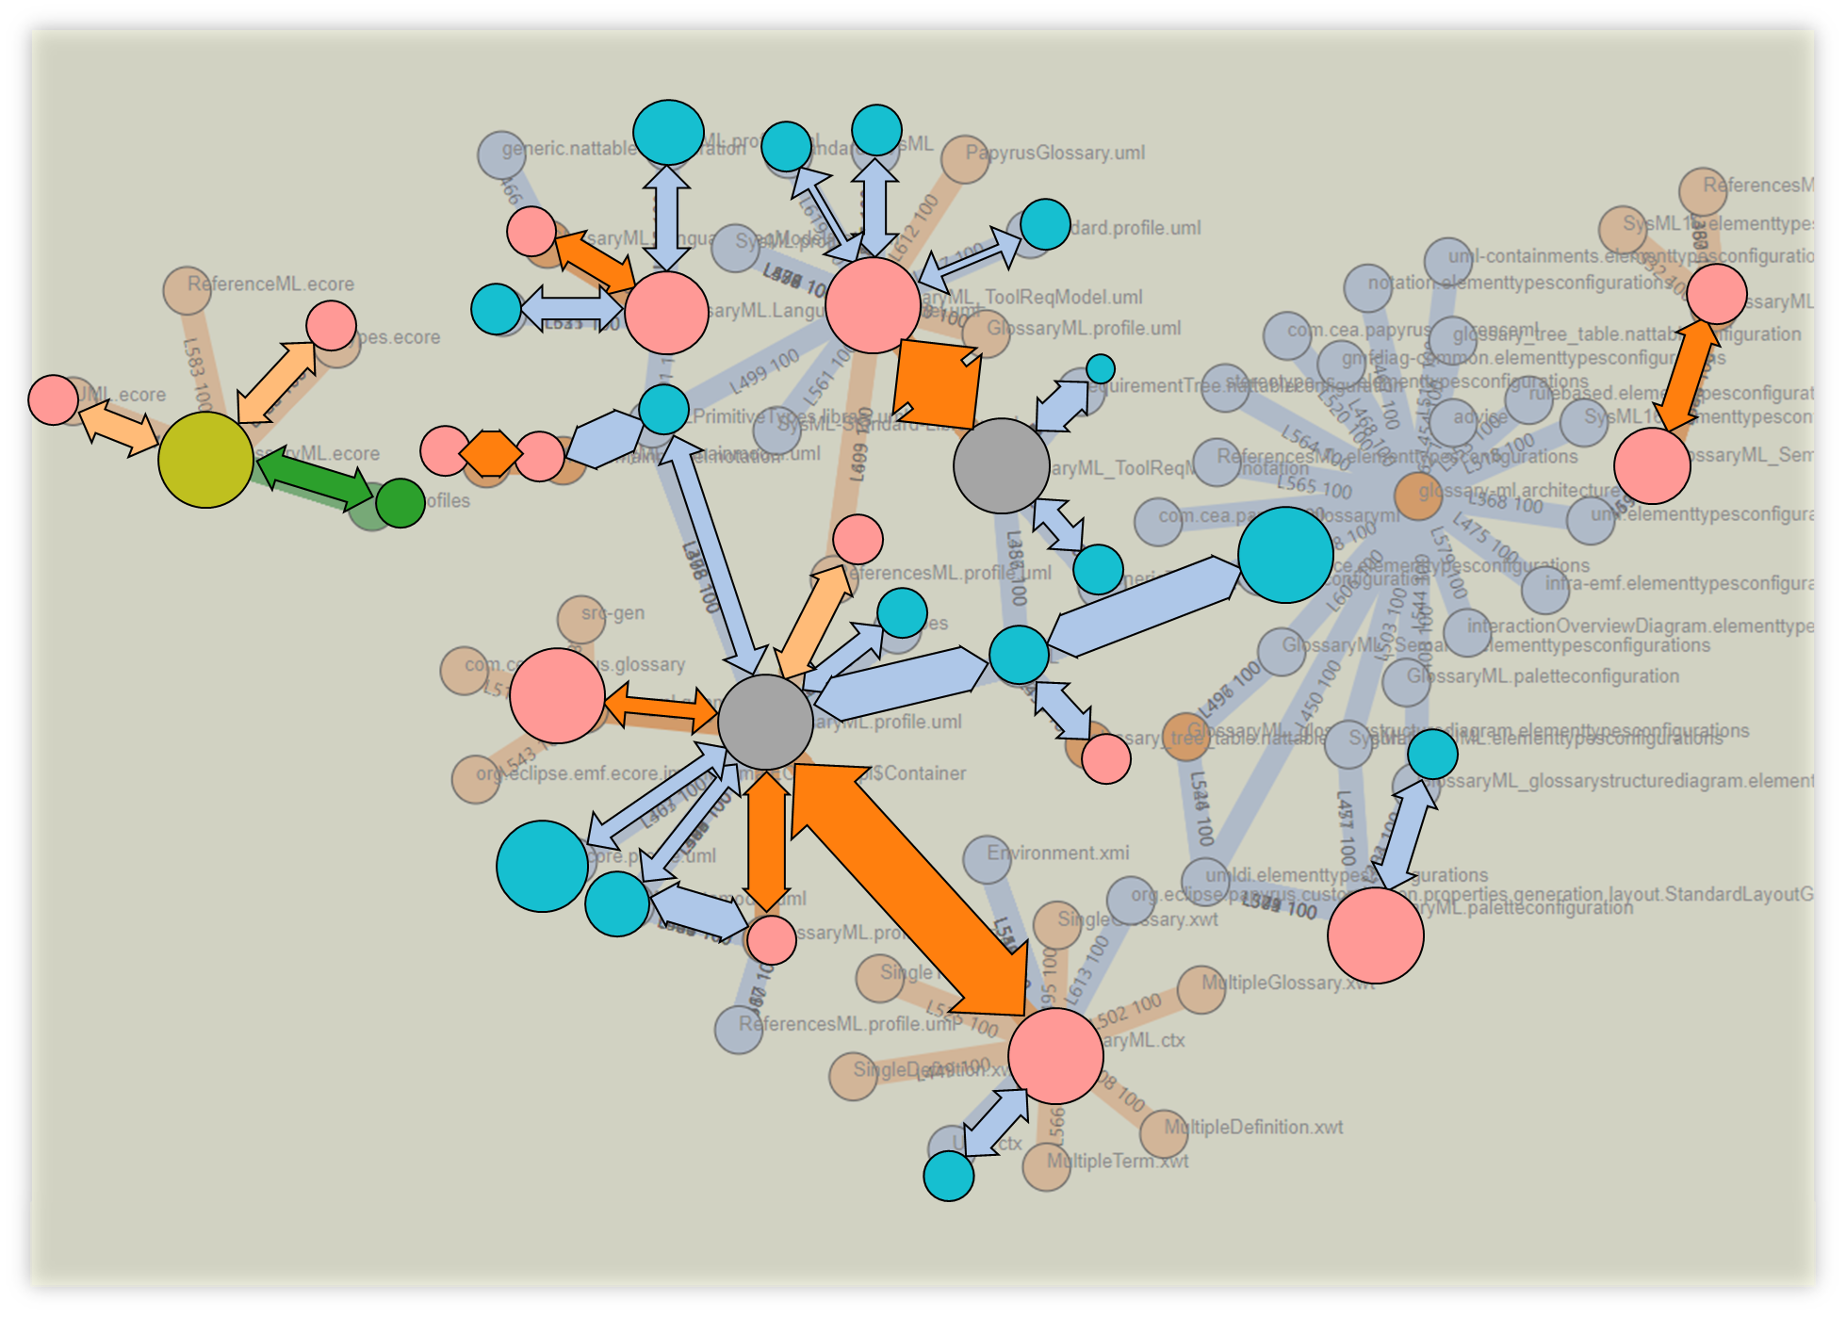
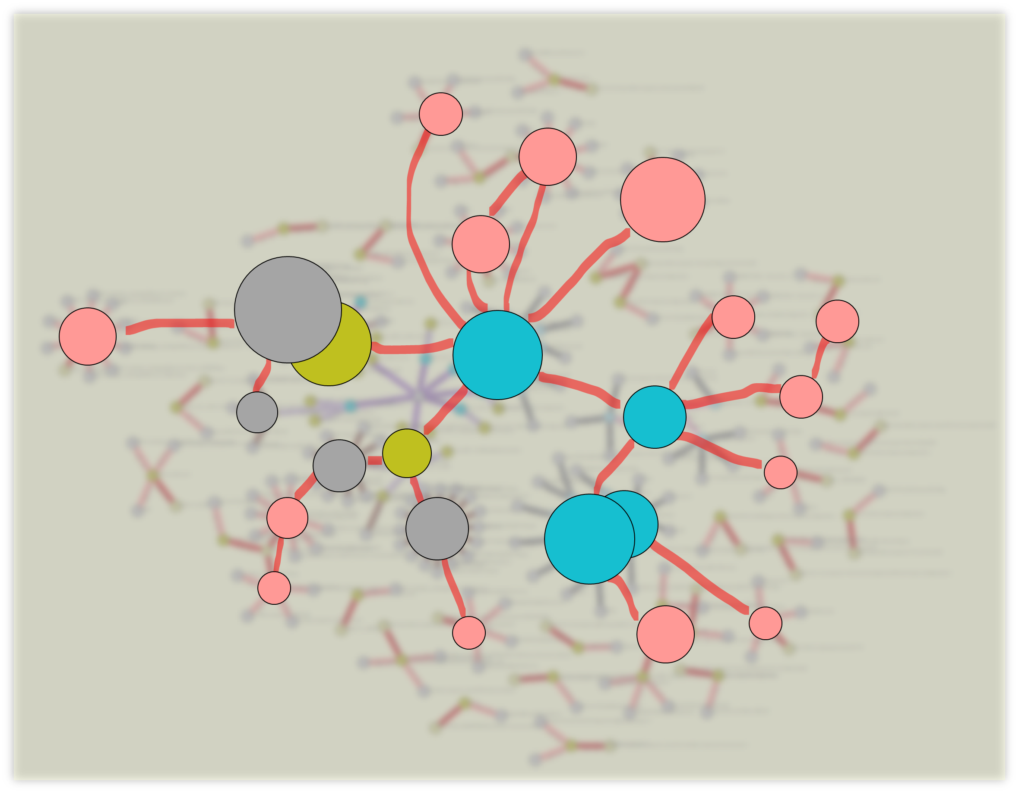
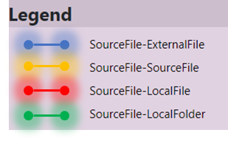
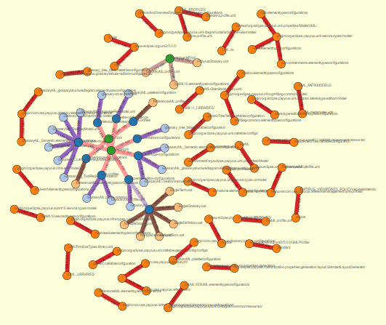
Intangible future
Topology
Complexity
Reference forensic
Exploring Papyrus typology

Slide 18
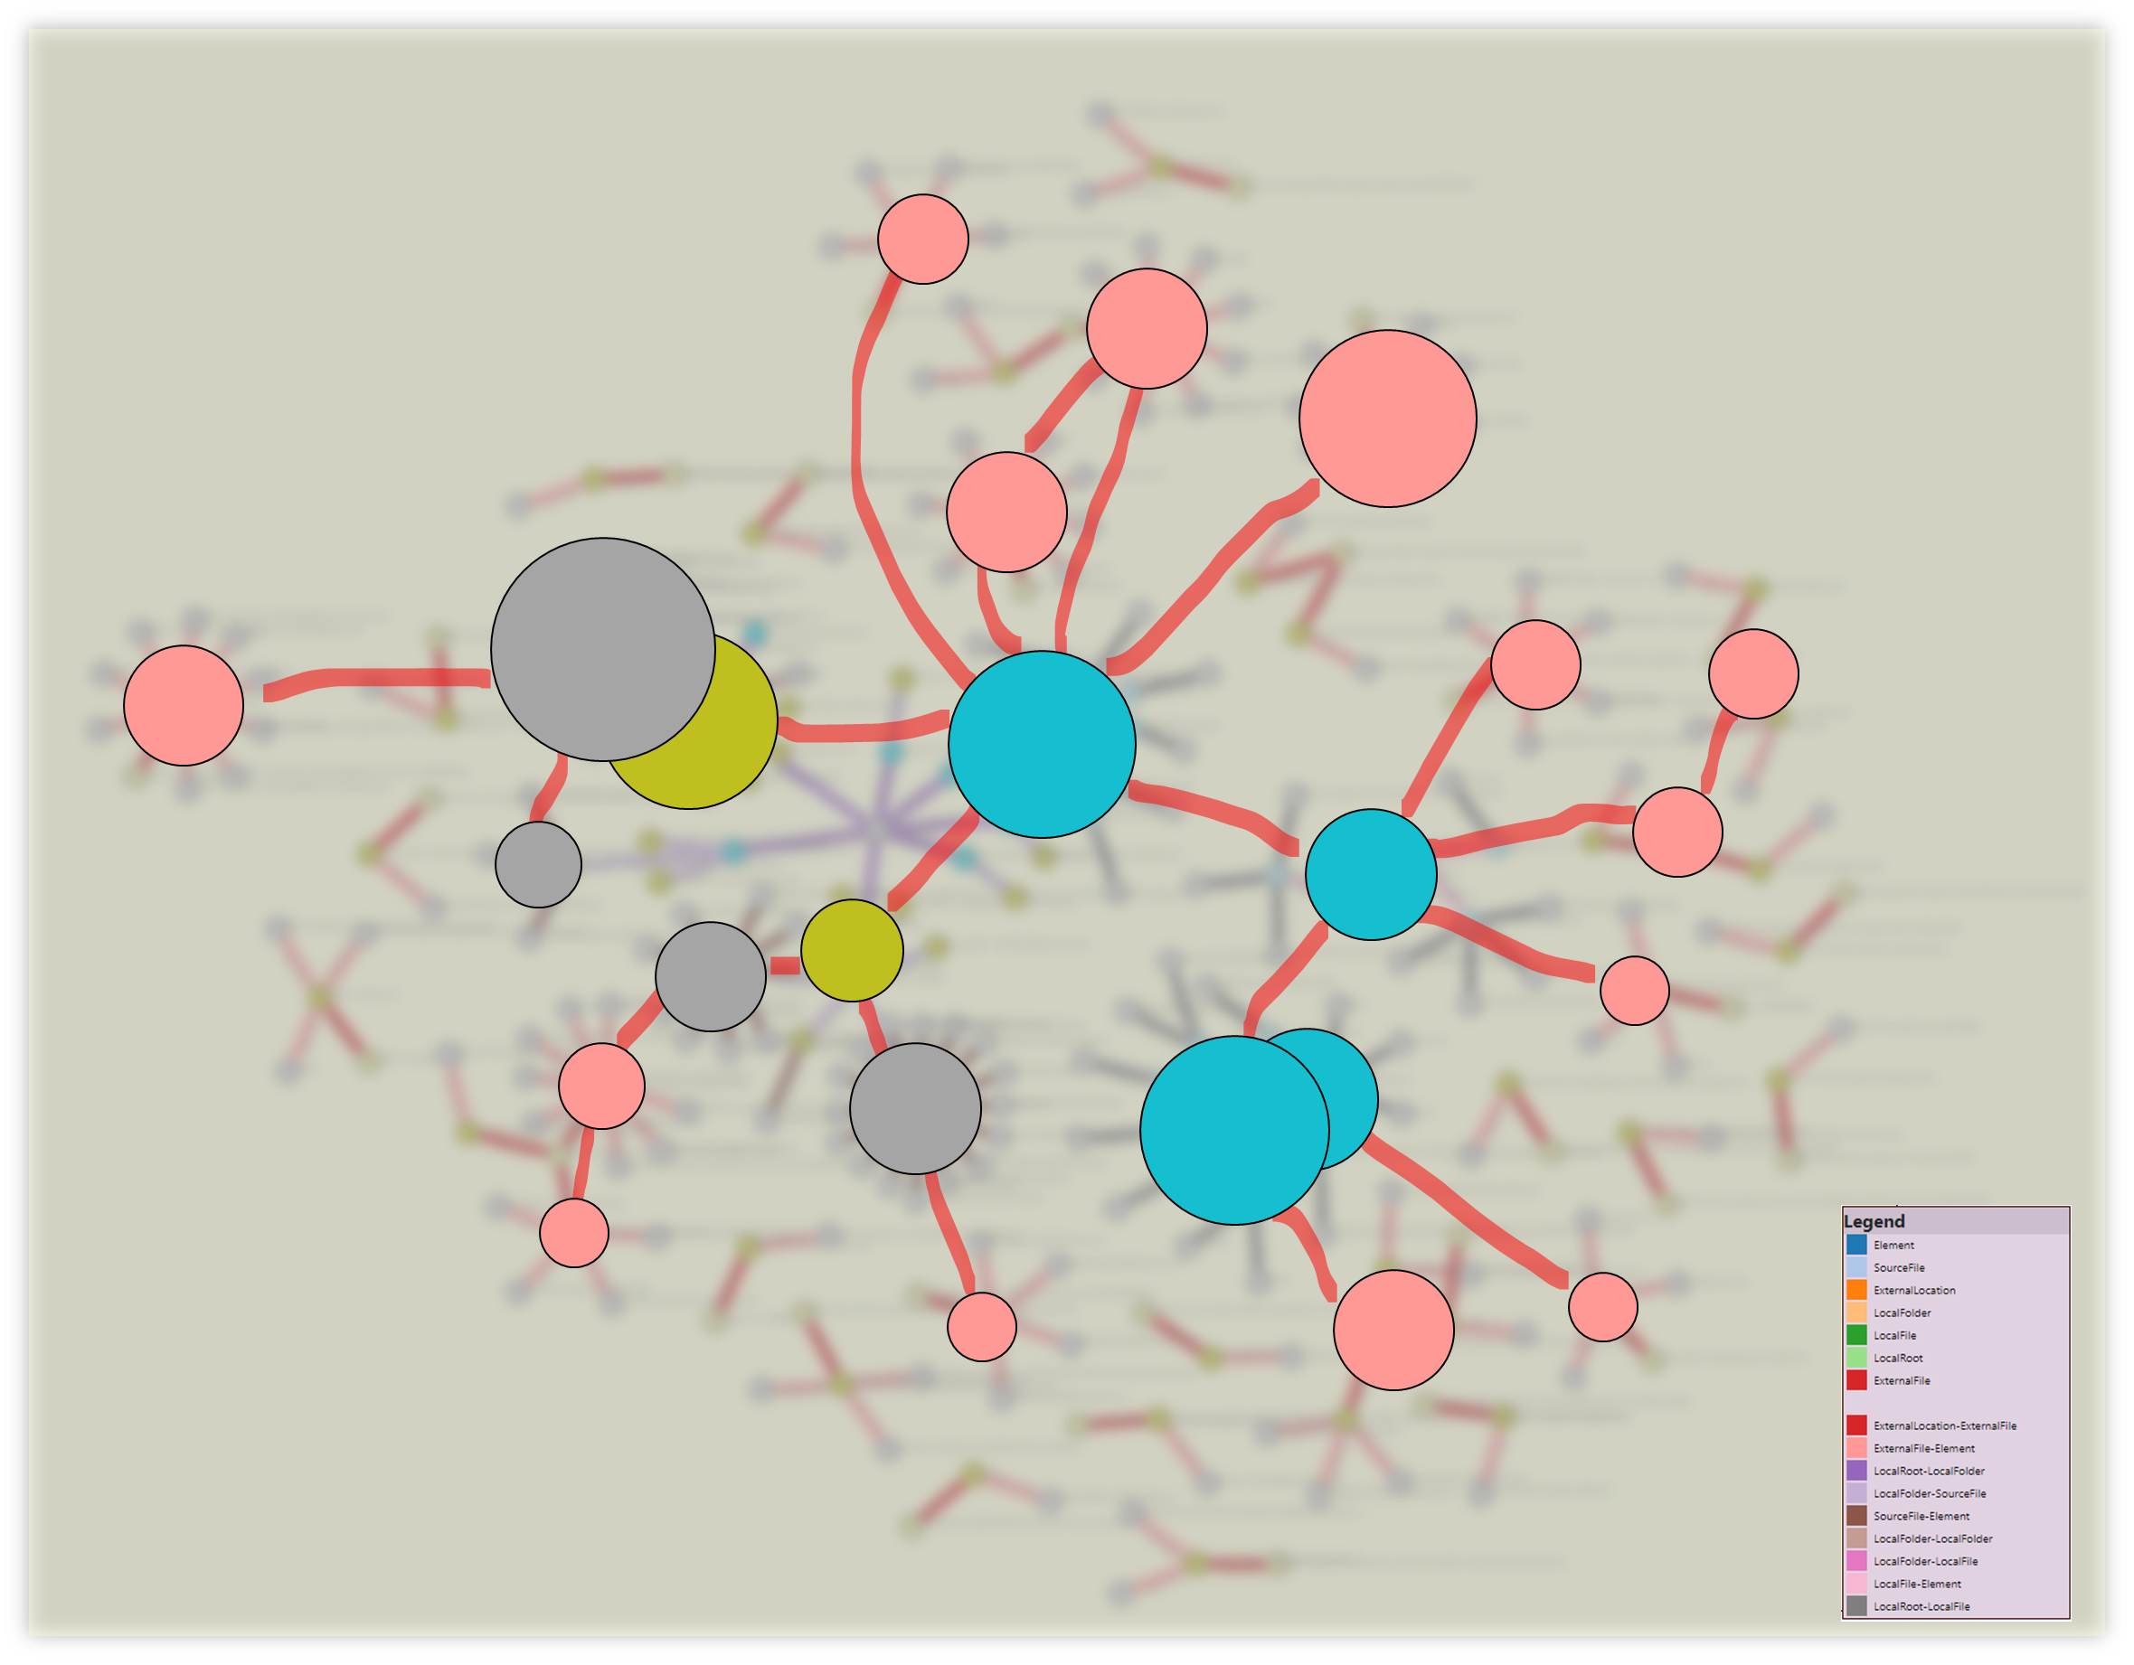
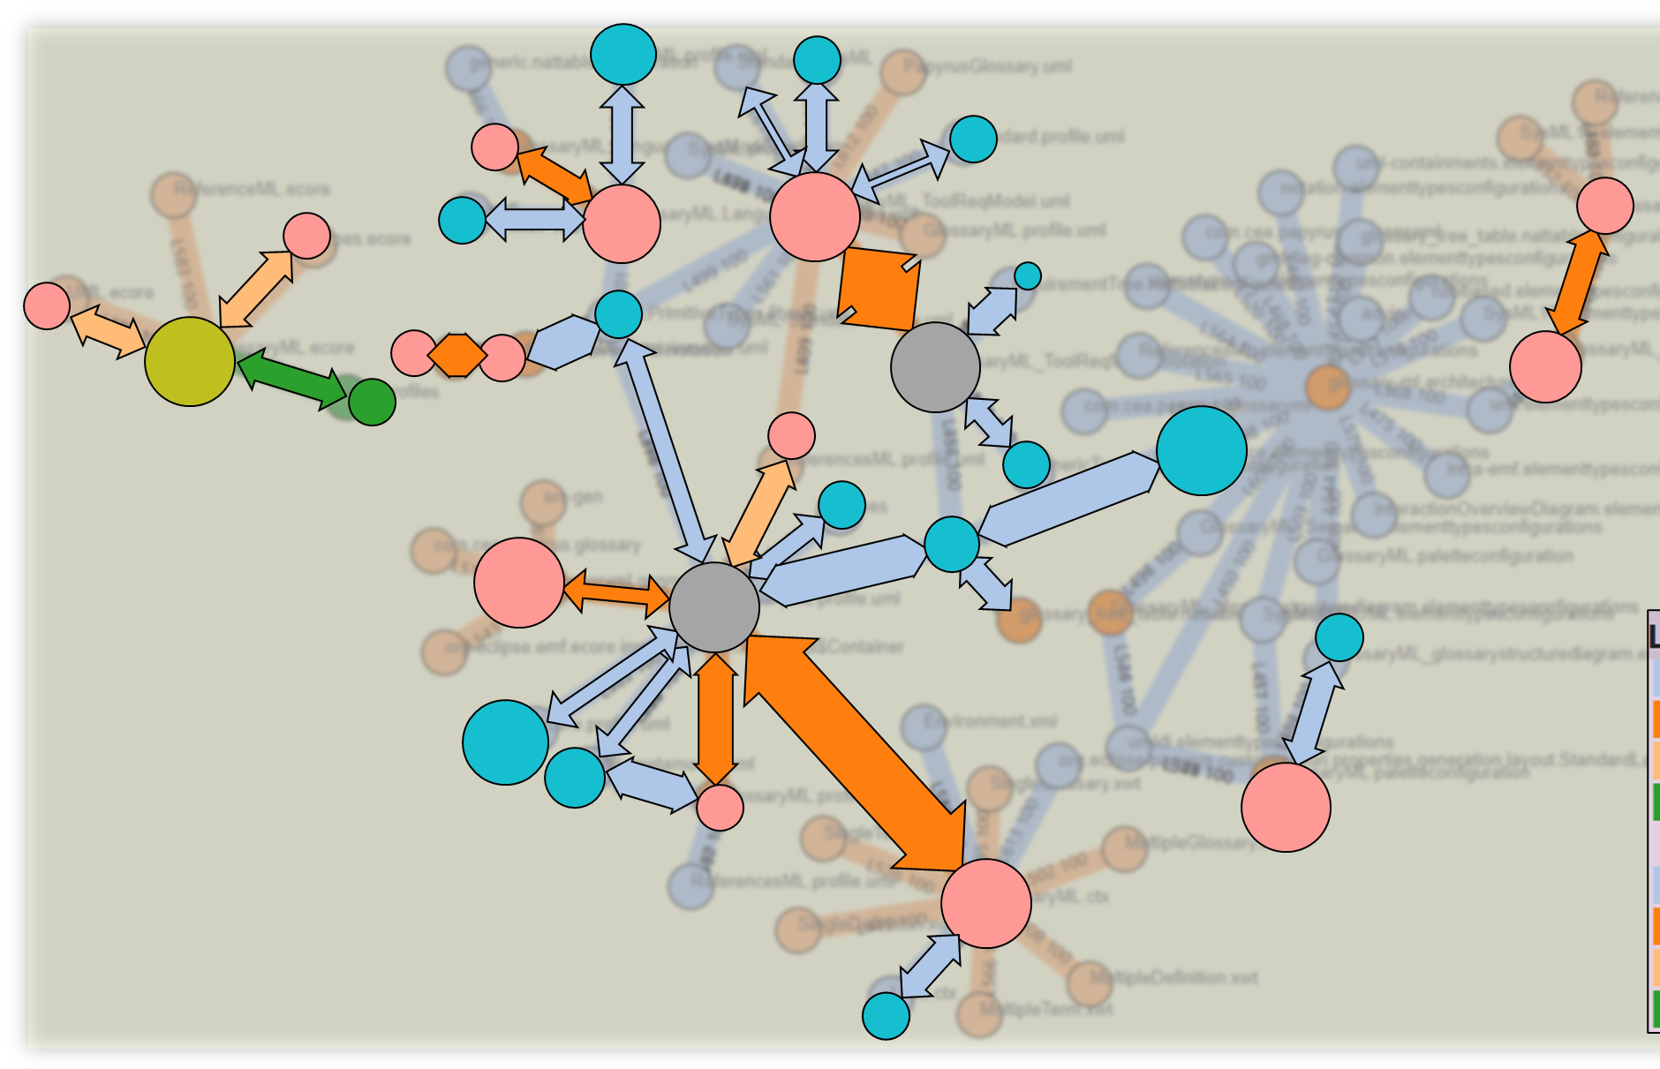
Intangible future
Topology
Complexity
Reference forensic
Exploring Papyrus typology

Slide 19
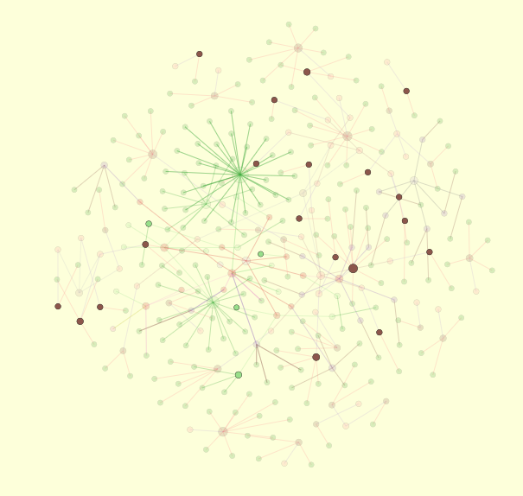
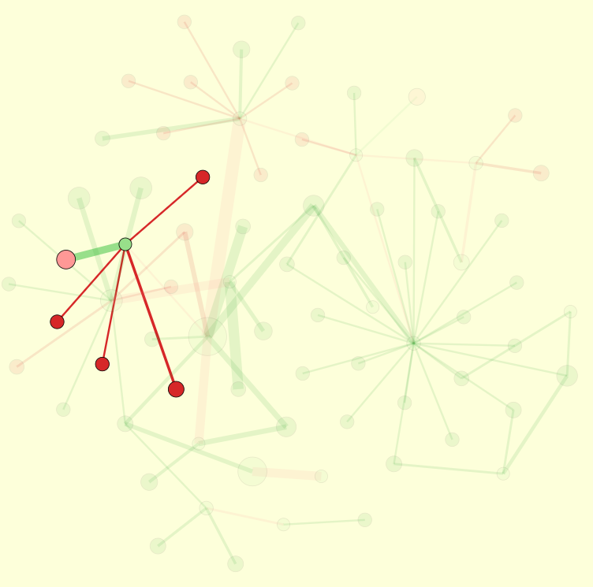
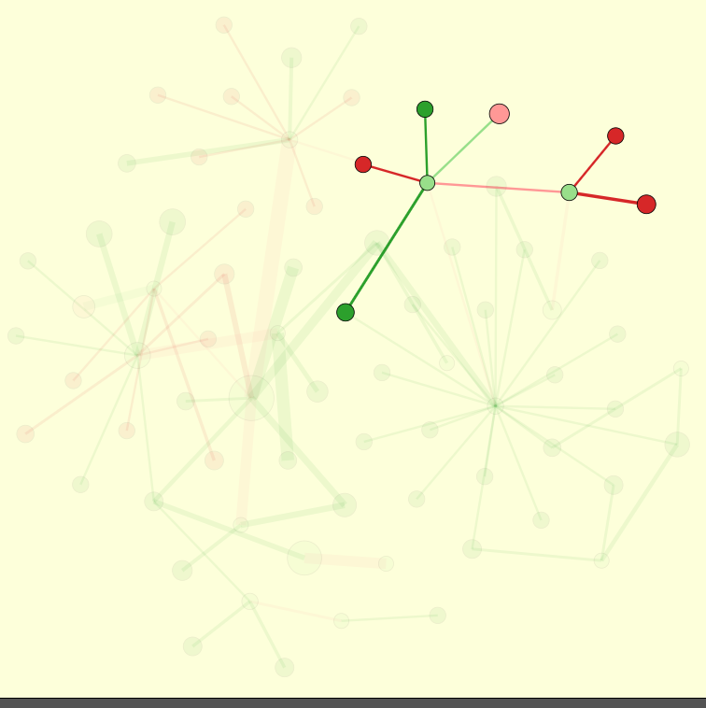
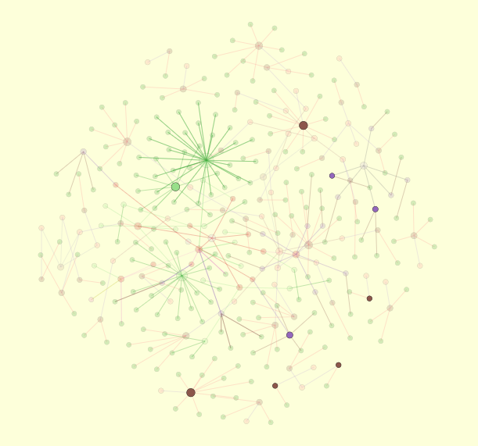
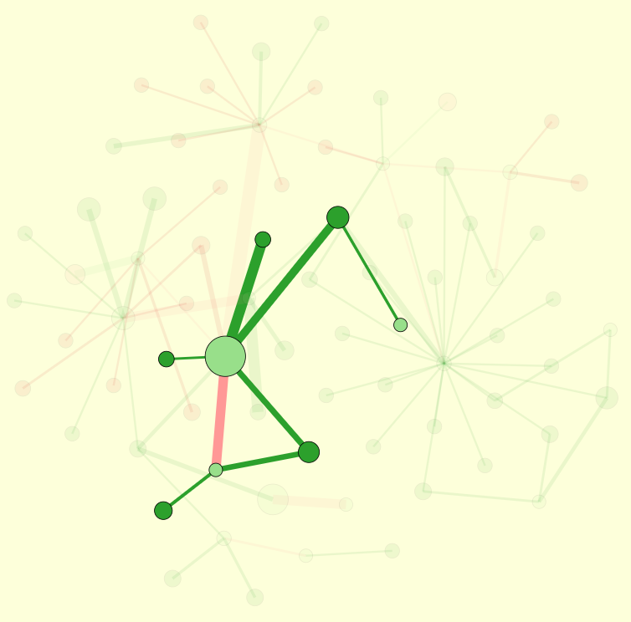
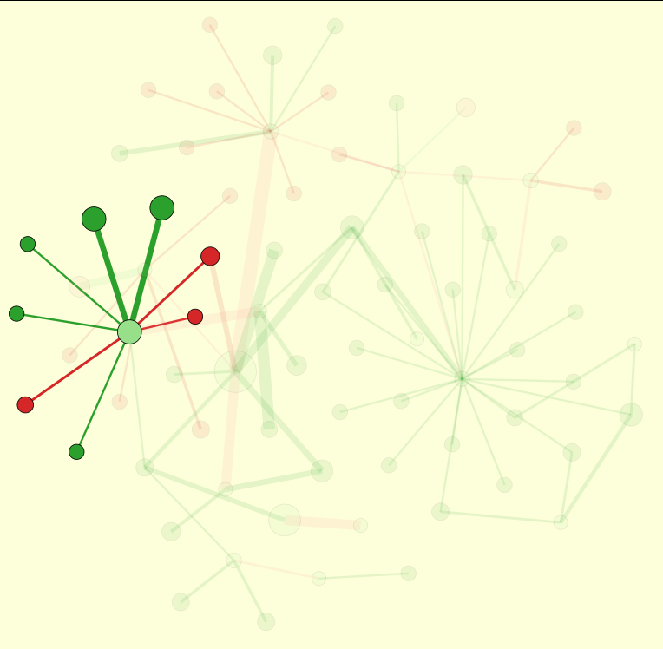
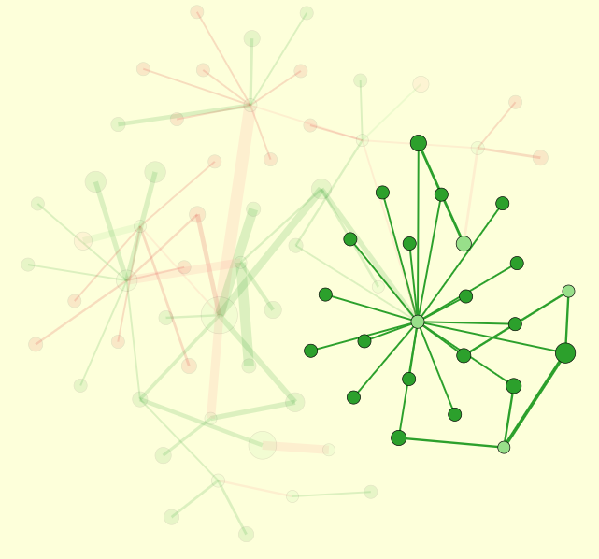
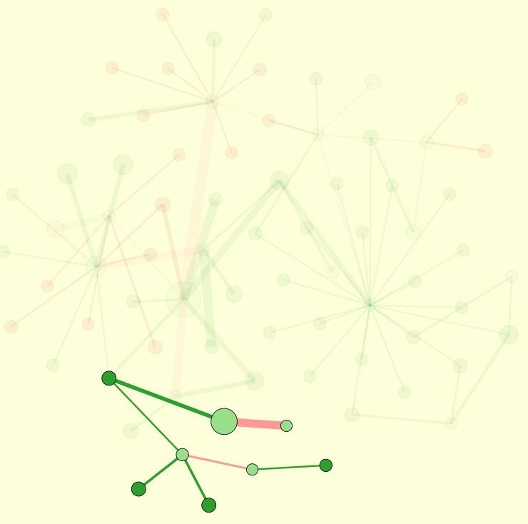


Topology and distance in a Papyrus project
Reference forensic
Exploring Papyrus typology

Slide 20


















Topology and distance in a Papyrus project
Automated analysis
Reference forensic
Exploring Papyrus typology

Slide 21




Topology and distance in a Papyrus project
Reference forensic
Exploring Papyrus typology

Slide 22








Working space
Reference forensic
Exploring Papyrus typology
Folder
Elt
File
File
File
Folder
Elt
Elt
Elt
Elt
Folder
File
File
Elt
File
File
File
Elt
File
Elt
Elt
Elt
Elt
Elt
Elt
Elt
Elt
Elt
Elt
Elt
Elt
Elt
External Location
External Location
Elt
External Location

Slide 23
Topology and distance in a Papyrus project
Reference forensic
Exploring Papyrus typology
data/input_trace_data.json&nc=4&lc=4

Slide 24


Reference identification and visualization
Reference forensic
Exploring Papyrus typology

Slide 25





Slide 26
Topology and distance in a Papyrus project
Reference forensic
Exploring Papyrus typology
The bigger an element,
The most accessed

Slide 27

Complexity of
a Papyrus project
Reference forensic
Exploring Papyrus typology

Slide 28
Reference plastic
Artefact
Artefact
Artefact
Protocol
External
Location
Local
Folder
Root
Location
Artefact
Context
resolves?
Name
Inner location
Artefact
External
File
exists?
Local
File
File Artefacts
Element
Precise
Artefact
EMF Realm

Slide 29







Topology and distance in a Papyrus project
Papyrus
Reference forensic
Exploring Papyrus typology
UML
SysML
GlossaryML
ReferenceML

Slide 30
EMF Realm

Slide 31


A study of Papyrus: Orchestration for DSL modeling
Inter-module connections
Impacted elements
Design
Code
Inter-module connections map
Profiling
Maps modules external dependencies
Eases exploration of dependencies
Guides type connections
Architecture
Element Type configuration
Palettization

Slide 32



A study of Papyrus: Orchestration for DSL modeling
Inter-module connections detailed
Design
Other modules
UML element
UML Primitives
Related
libraries
SysML element
XML et al.
SysML 1.6
View
Context
Design
Architecture
Profiling
Palettization
Code
Element Type configuration
Related project
Project
EMF Realm

Slide 33
A study of Papyrus: Orchestration for DSL modeling
Inter-module connections detailed
Module
Other modules
Root
Path to element
Path to element
Specific Element
Path to element
External location
Specific Element
Related
libraries
External location
Specific Element
View
Context
Design
Architecture
Profiling
Palettization
Code
Element Type configuration
Related project
Project
EMF Realm

Slide 34




Orchestration for DSL modeling: A study of Papyrus
Element type configurations:
from domain model to EMF representations
? Related projects ?
Glossary
DSL
Reference management DSL

Slide 35

Orchestration for DSL modeling: A study of Papyrus
Customization and dependencies

Slide 36



Orchestration for DSL modeling: A study of Papyrus
Papyrus external elements
Missing
Profile / Definition ?
Domain – SysML
Dependency

Slide 37


Orchestration for DSL modeling: A study of Papyrus
EMF ResourceSets & Resources
Definition
Usages
Related project
CreationMenu resources
Architecture resources

